Slide 1
DECISION MAKING
C PROGRAMMING LANGUAGE FULL HINDI COURSE

Slide 2
DECISION MAKING
IF STATEMENTS
IF ELSE STATEMENTS
NESTED IF
IF ELSE IF LADDER
SWITCH STATEMENTS
JUMP STATEMENTS

Slide 3
IF STATEMENTS
If statement is the most simple decision making statement. It is used to decide whether a certain statement or block of statements will be executed or not i.e if a certain condition is true then a block of statement is executed otherwise not.

Slide 4
IF STATEMENTS
if(condition)
{
// Statements to execute
if // condition is true
}

Slide 5
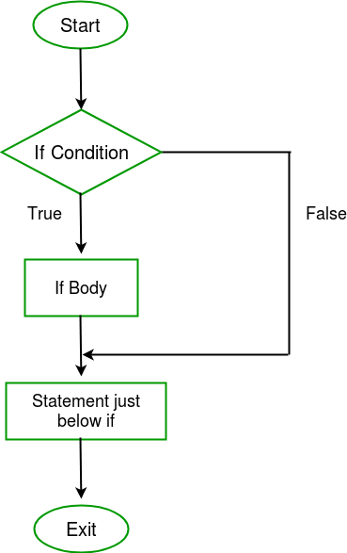
IF STATEMENTS USING FLOWCHART

Slide 6
IF ELSE STATEMENTS
The IF statement alone tells us that if a condition is true it will execute a block of statements and if the condition is false it won’t. But what if we want to do something else if the condition is false. Here comes the IF ELSE statement. We can use the else statement with if statement to execute a block of code when the condition is false.

Slide 7
IF ELSE STATEMENTS
if (condition)
{
// Executes this block if
// condition is true
}
else
{
// Executes this block if
// condition is false
}

Slide 8
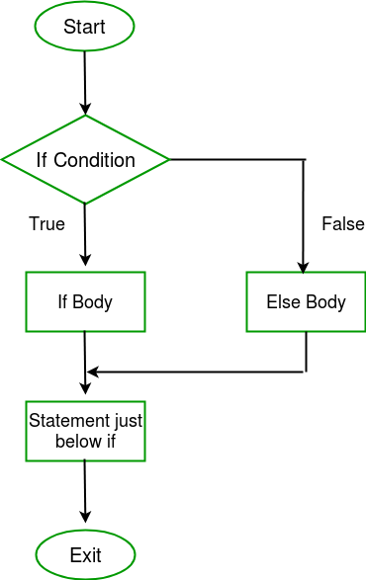
IF ELSE STATEMENTS

